Slide 1
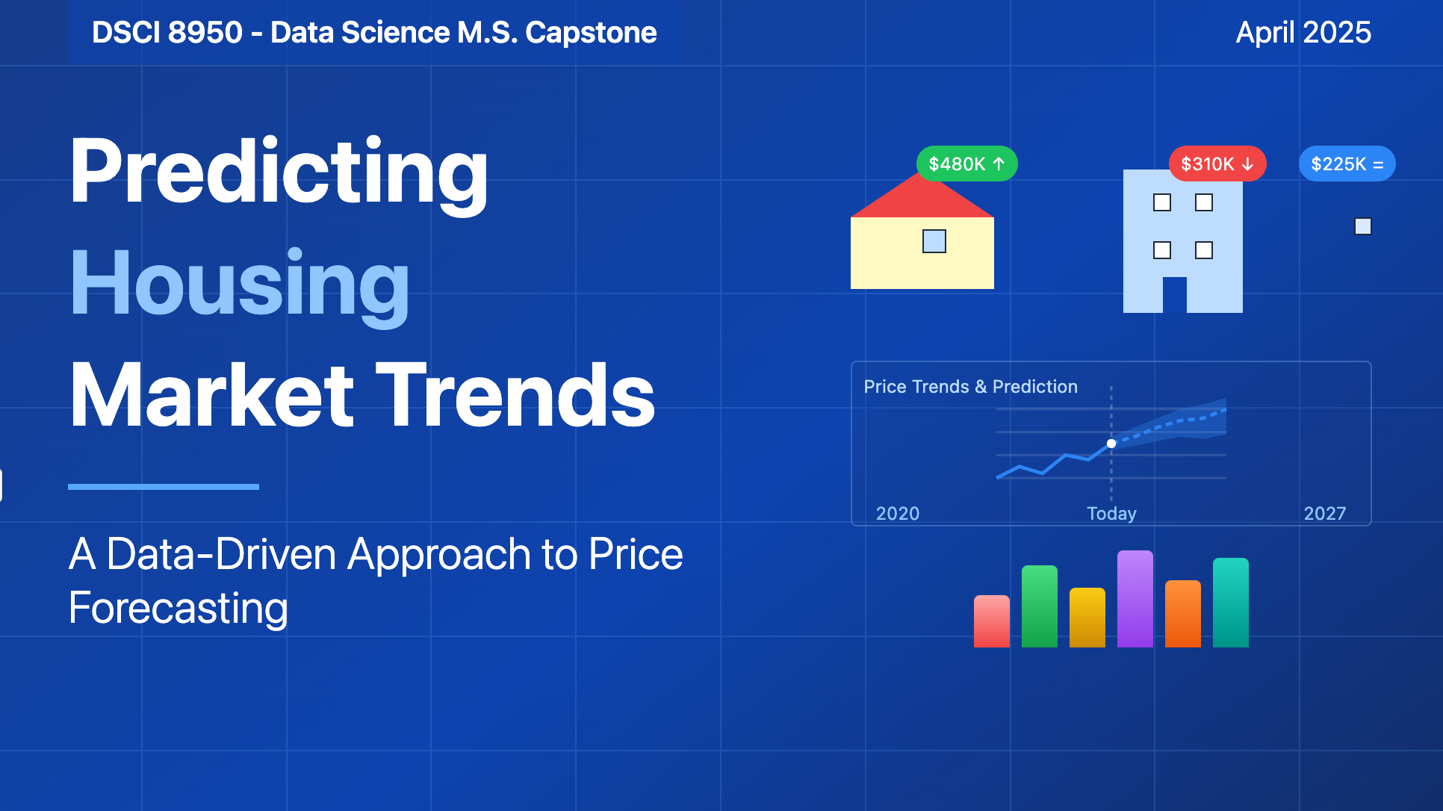

Slide 2




Team Outliers
Amarnath
Sandeep
Vikash
Kavya

Slide 3
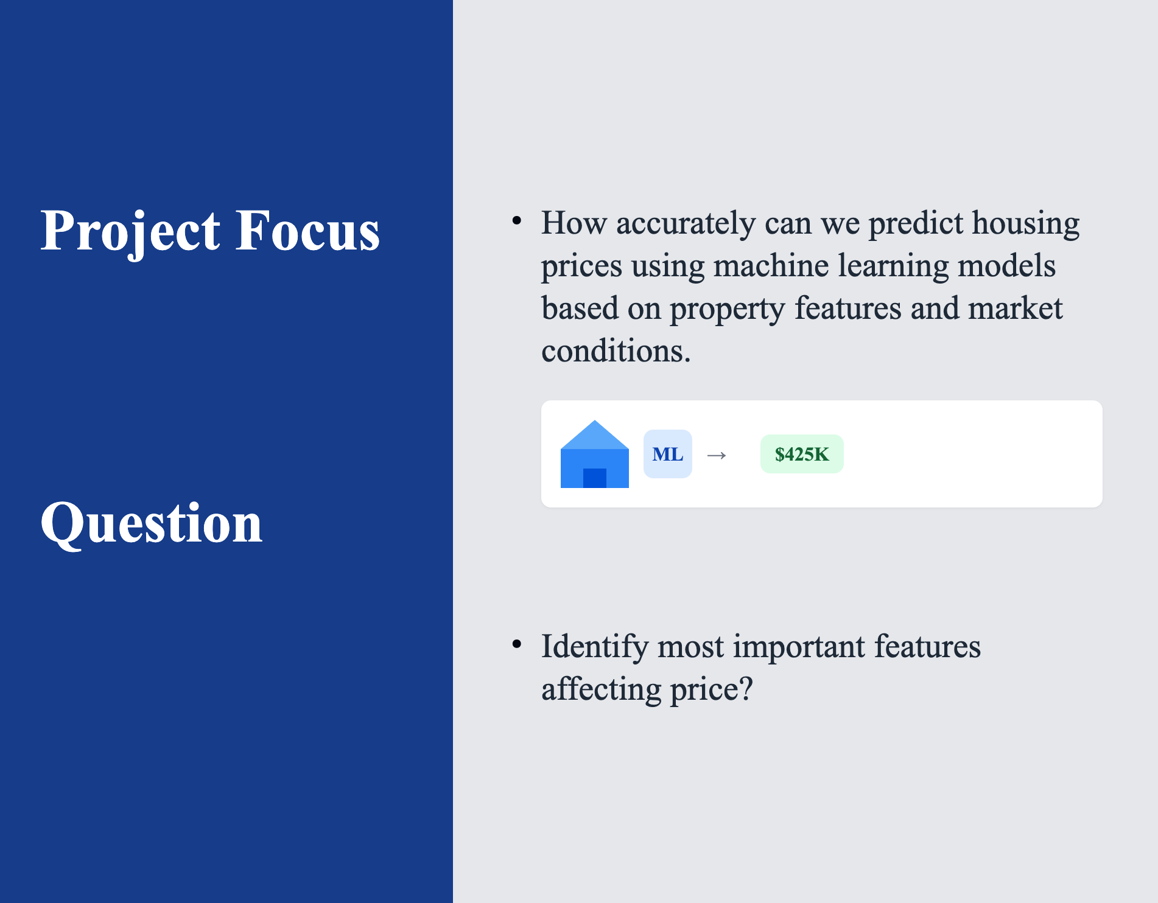
Question
Notes:
Our project was focused on creating a machine learning model that predicts housing prices in the United States based on a number of variables including inflation rates, unemployment, rates, gas prices, interest rates and mortgages

Slide 4




Objective of the Study
Leverages historical data to identify patterns and correlations.
Improves accuracy by reducing human bias in price estimation.
Provides quick, data-driven predictions based on market conditions.
Develop a machine learning model to predict housing prices.

Slide 5
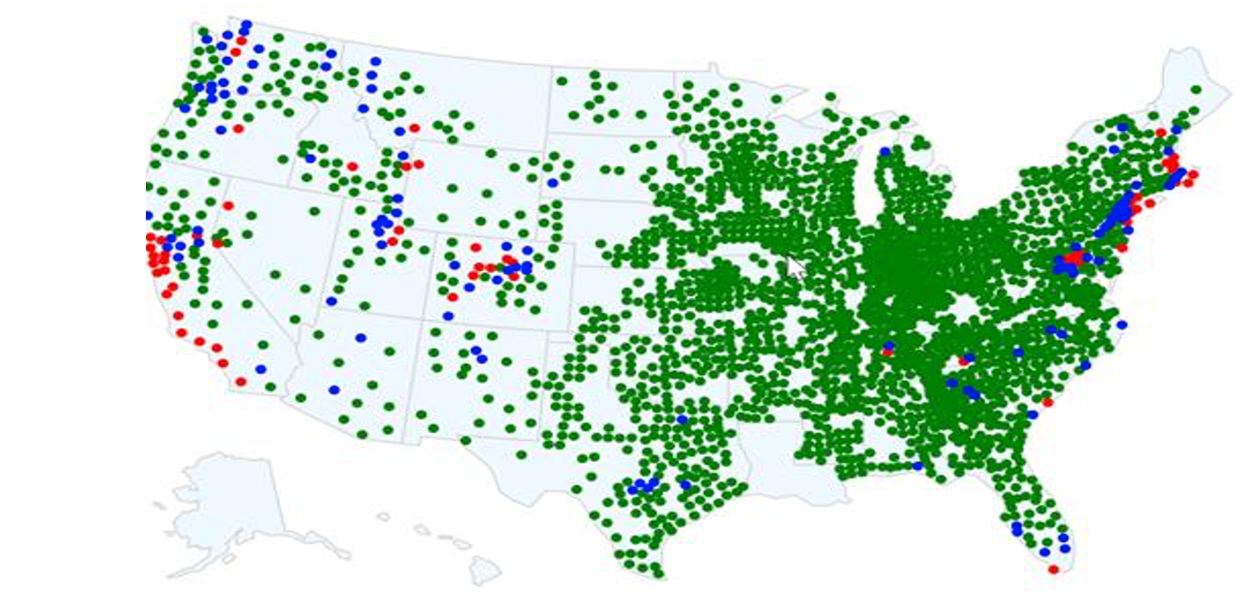
2024 U.S. County Home Values – At a Glance
< 500K
500K – 700K
> 700K
West Coast → 83 % counties > $700K Midwest → 92 % counties < $500K
Green dominates → Most U.S. counties still under $500K

Slide 6
Dataset Overview — Snapshot
📅 2020‑2024
Sources: Zillow + U.S. BEA
🏠 52K Home‑value rows
Across 5 property dataset (~10.5 K each)
📈 3 Economic drivers
Personal & Per‑Cap Income Population Growth merged
🗺️ County Level
3 K+ counties nationwide

Slide 7
Data Cleaning & Preprocessing
Data Sources
Files Integration
Data Merging
Schema Refinement
Feature Engineering
Final Formatting
Zillow Dataset - multiple files with real estate and per capita income data.
Counties-level per capita income and housing values
Zillow Home Value Index
Population, Income data
Merging Files for different house types
Rename columns to make meaningful names
Adding longitude,latitude,FIPS
Format data types & Removed missing values
Notes:
Zillow Dataset contains multiple files with real estate and per capita income data.
Files Included:
Counties-level per capita income and housing values
Zillow Home Value Index (ZHVI) for 2-bedroom and 3-bedroom homes
Income data at the county and zip code levels
Merging the files to make a common file
Rename columns to make menaingfull names
Adding longitude,latitude,FIPS to show for maps
Added data for Per_Capita_Income_Growth, Population_Growth, Personal_Income_Growth
Removed missing values

Slide 8
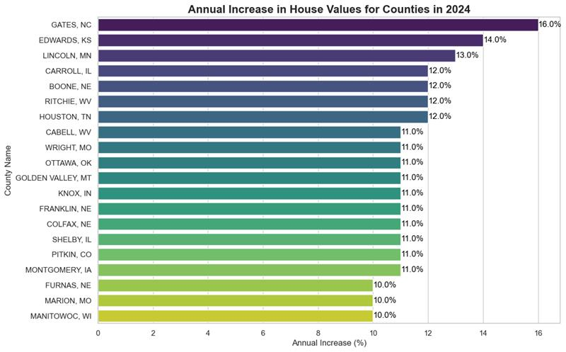
Annual Increase in House Values
Top Performers:
🏆 GATES, NC: Leading with a 15.0% increase.
🥈 EDWARDS, KS: Close behind with a 14.0% increase.
🥉 LINCOLN, MO and CARROLL, NE: Both showing a 12.0% increase.
Notes:
The bar chart titled "Annual Increase in House Values for Counties in 2024" illustrates the percentage increase in house values across various counties. Here are the key points:
Top Performers:
GATES, NC: Leading with a 15.0% increase.
EDWARDS, KS: Close behind with a 14.0% increase.
LINCOLN, MO and CARROLL, NE: Both showing a 12.0% increase.
Moderate Increases:
BOONE, NC: 11.0%
HARLAN, WI: 10.0%
WORTH, IA and CAMBEL, WV: Both at 9.5%
WIRT, OH: 9.2%
Lower Increases:
ORANGEVILLE, NY: 8.7%
GOLDEN VALLEY, MT: 8.5%
KNOX, IN: 8.2%
FRANKLIN, ME: 7.6%

Slide 9
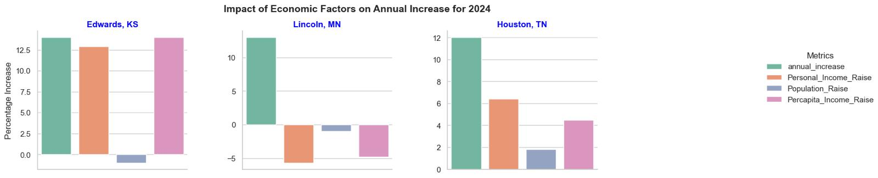
Annual Increase Vs Economic Factors
The overall trend indicates that counties with higher median income rates and population growth tend to have higher annual increases in house values.

Slide 10
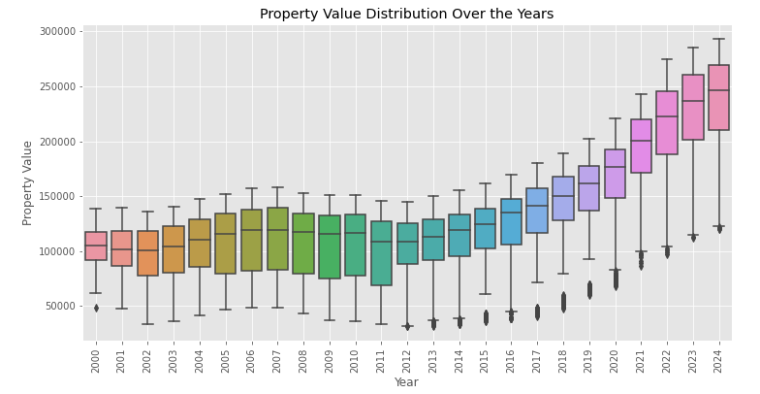
Property Value Distribution Over Years
Observations:
Rising Median Values: Median property values have risen consistently over the period, indicating an overall upward trend in property prices.
Variability: There is noticeable variability in property values each year, with some years showing wider IQRs than others.
Outliers: Present in most years, suggesting that there are some properties with significantly higher or lower values compared to the majority.
Notes:
Increasing Property Values: Property values have generally increased over time from 2000 to 2024.
-->Variability: There is noticeable variability in property values each year, with some years showing wider IQRs than others.
-->Rising Median Values: Median property values have risen consistently over this period, indicating an overall upward trend in property prices.
-->Outliers: Present in most years, suggesting that there are some properties with significantly higher or lower values compared to the majority.

Slide 11
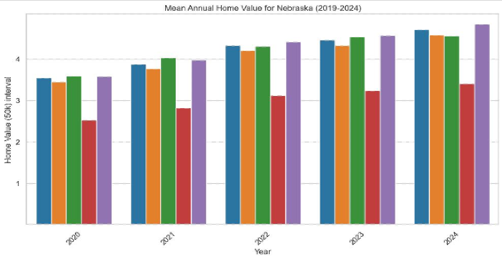
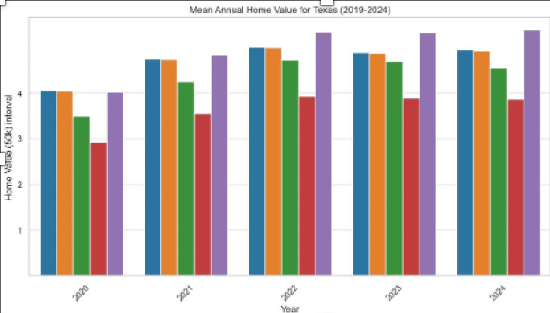
Nebraska vs Texas • Annual Home‑Value Growth (2019‑2024)
■ AllHomes ■ Condo ■ Single Family ■ ThreeBed ■ TwoBed
Nebraska
+4.6%
CAGR
Texas
+5.0%
CAGR
• All property types rose together each year.
• Gains move almost in lock‑step (~90% correlation).
• Parallel rise across categories, slightly steeper.
• Condos lag a bit, but trend remains strong.
Key Insight: In both states, different home types move together—diversify by geography, not property type.

Slide 12

Final Dataset for Model Build
Zillow House‑Price
Key Variables
Personal_Income_Growth
Population_Growth
PerCapita_Income_Growth
AnnualValue_Allhomes
AnnualIncrease_Allhomes
AnnualValue_SingleFamily
AnnualIncrease_SingleFamily
5Year_BasePrice

Slide 13

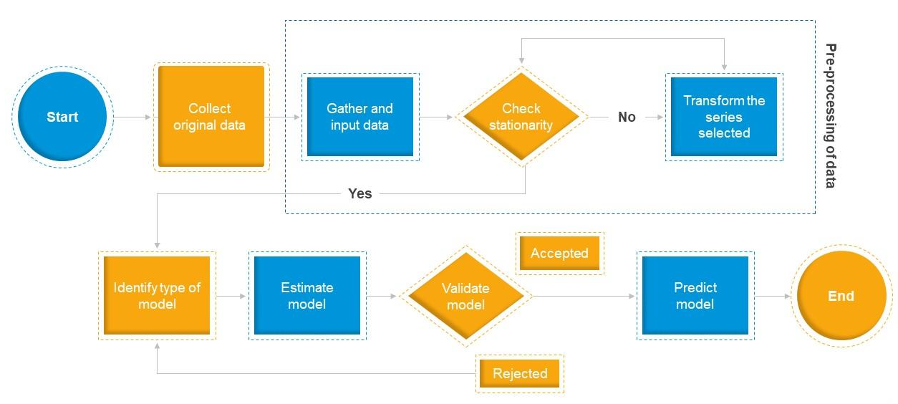
Time Series Models
Image from internet source
Notes:
Lets move into the time series models we explored to predict 2024 house prices. We experimented with ARIMA, SARIMA, Prophet, and LSTM. Our goal was to minimize forecasting errors while capturing patterns like seasonality and trends in house values.

Slide 14
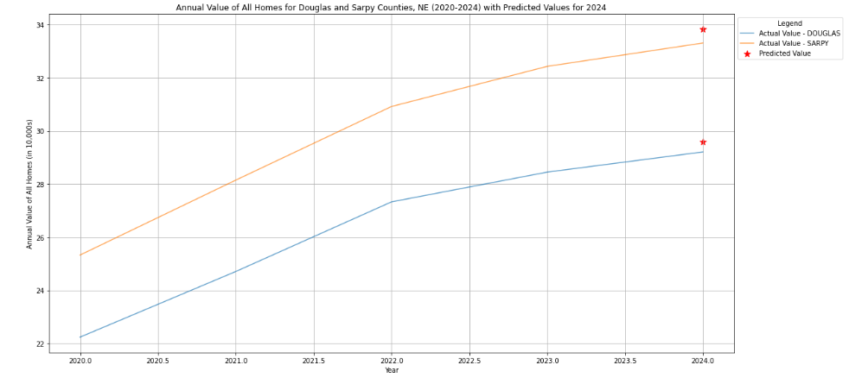
ARIMA - Autoregressive (AR), Integrated (I), and Moving Average (MA) Forecast
Time series forecasting - data shows patterns over time without seasonality.
Predicts 2024 prices with Avg RMSE = 1.3 | MAE = 0.7
Error Breakdown
Actual vs Forecast
Lower = better
Notes:
We started with ARIMA, which combines autoregressive terms, differencing to make the data stationary, and moving averages. ARIMA was able to predict 2024 prices within a range of plus or minus $25,000. We achieved an average RMSE of 1.3 and an MAE of 0.5. However, ARIMA doesn’t naturally account for seasonal patterns, which is a limitation for real estate data

Slide 15
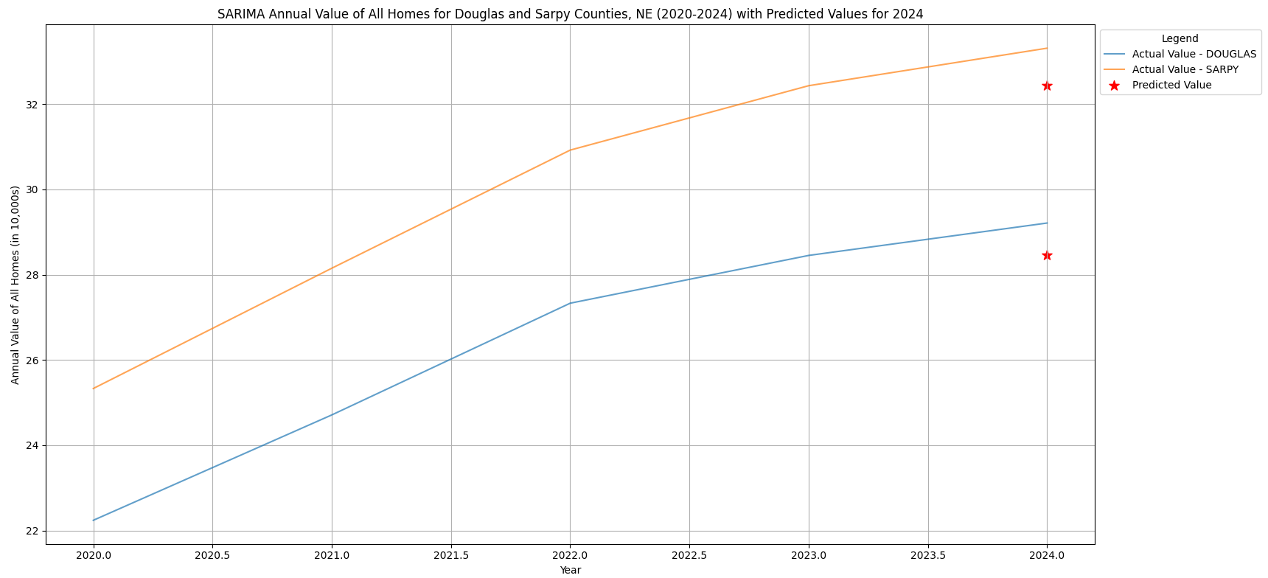
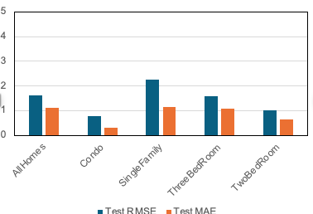
SARIMA – Seasonal ARIMA
Forecast
Extension of ARIMA - supports seasonality in the data.
Seasonality boost: Avg RMSE = 1.6 | MAE = 1.14
Error Breakdown
Actual vs Forecast
Lower bars = better accuracy
Notes:
To address seasonality, we moved to SARIMA, or Seasonal ARIMA. By incorporating seasonal components, SARIMA reduced forecast errors by about 15% compared to ARIMA. We achieved an improved RMSE of 1.1 and an MAE of 0.45. SARIMA was more consistent and accurate in capturing the repeating seasonal behavior seen in property prices

Slide 16
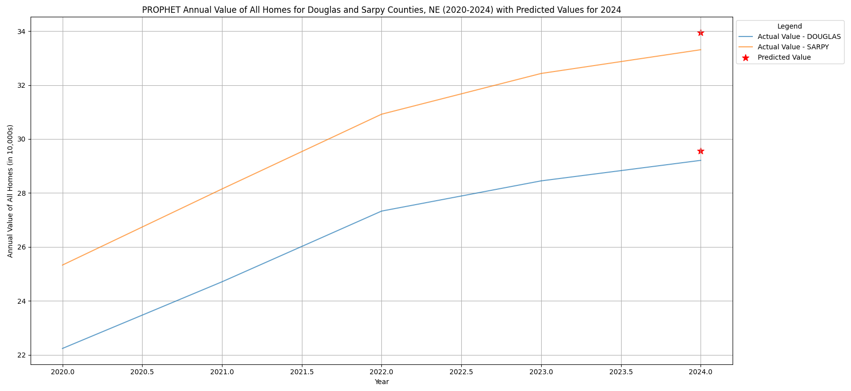
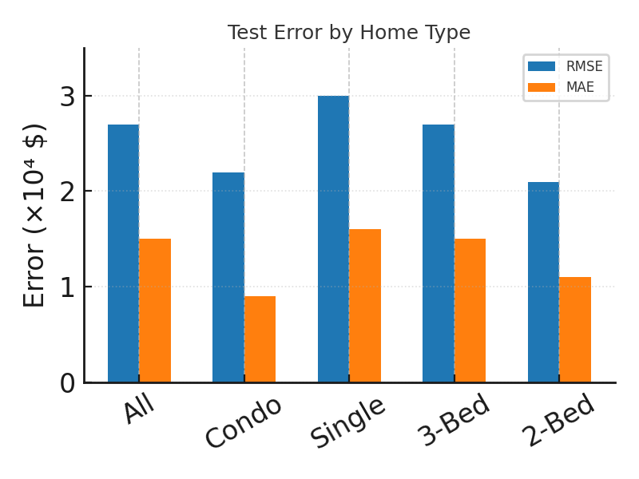
Prophet Forecast
Models trend + seasonality + holidays.
Prophet lags SARIMA ‑ roughly 2× the error.
Error Breakdown
Actual vs Forecast
Lower bars = better RMSE (prediction error)
Notes:
We also tested Prophet, developed by Facebook, which is good at modeling trends, holidays, and seasonality automatically. However, Prophet’s error was roughly double compared to SARIMA, although it still captured the general direction of price movements. It's a great tool for fast and flexible modeling, but in our case, it did not outperform SARIMA.

Slide 17
LSTM - Long Short-Term Memory Forecast
Captures long-term dependencies & nonlinear relationships.
Deep‑learning model, but higher error → overfits small dataset
Key Hyper‑Parameters
✓ Hidden size: 50 • Layers: 2
✓ Seq length: 12 months
✓ Epochs: 50 • LR: 0.001
Lower bars = better
Notes:
Finally, we applied LSTM, a deep learning model specialized for time series forecasting. Although LSTM can theoretically capture complex patterns, it didn’t perform well on our relatively small dataset. The model overfitted, resulting in a high RMSE of 7.3. This shows that sometimes traditional statistical models can outperform deep learning when the data size is limited

Slide 18
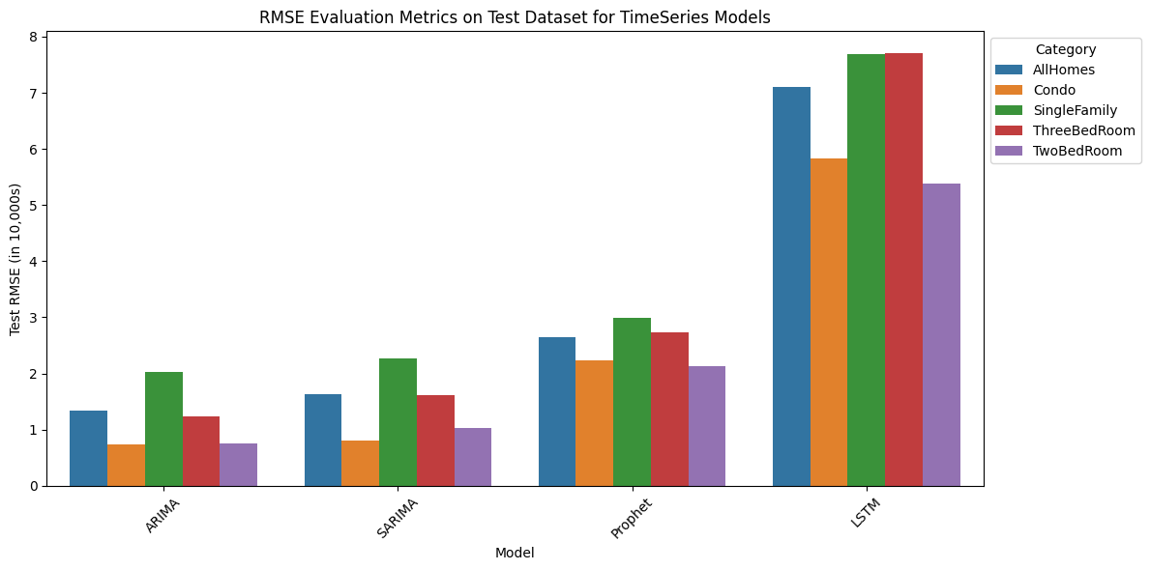
Time‑Series Model Shoot‑out
🏆 ARIMA is our most accurate model (≈20 % lower error than SARIMA)
Lower bars = better RMSE (prediction error)
Notes:
This slide summarizes the performance across all time series models. ARIMA emerged as the most accurate model, with approximately 20% lower error than SARIMA and much better stability than Prophet and LSTM. Based on this comparison, SARIMA was selected as our primary forecasting model for predicting future house prices.

Slide 19


Machine Learning Models

Slide 20
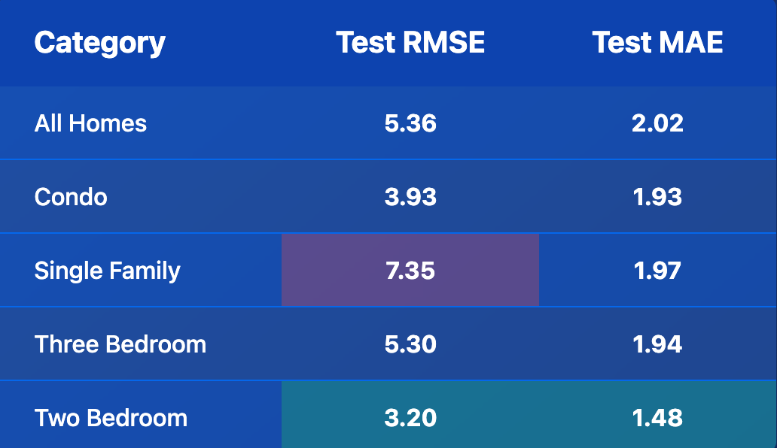
Random Forest – Quick Snapshot
Tuned Hyper‑Parameters
bootstrap = True
max_depth = None
max_features = 'sqrt'
min_samples_leaf = 1
min_samples_split = 2
n_estimators = 100
✔ Stable, low error across all segments
Blue = Test RMSE | Orange = Test MAE

Slide 21
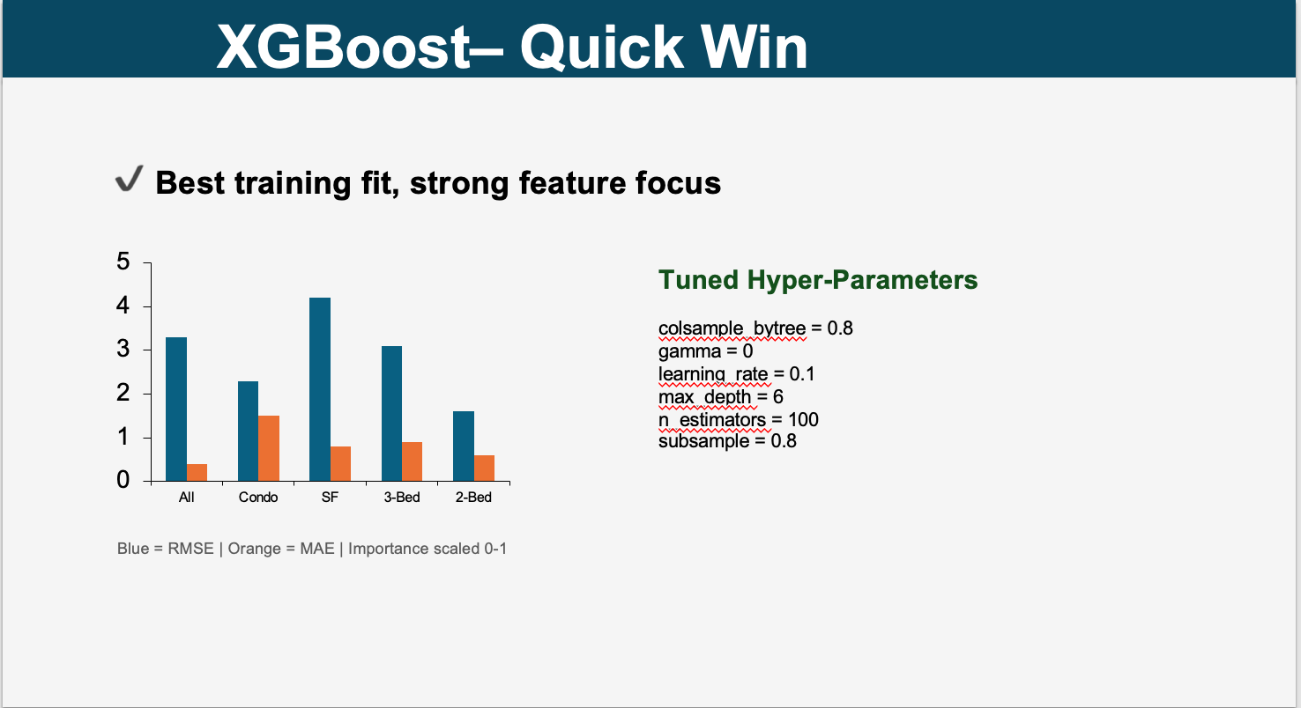
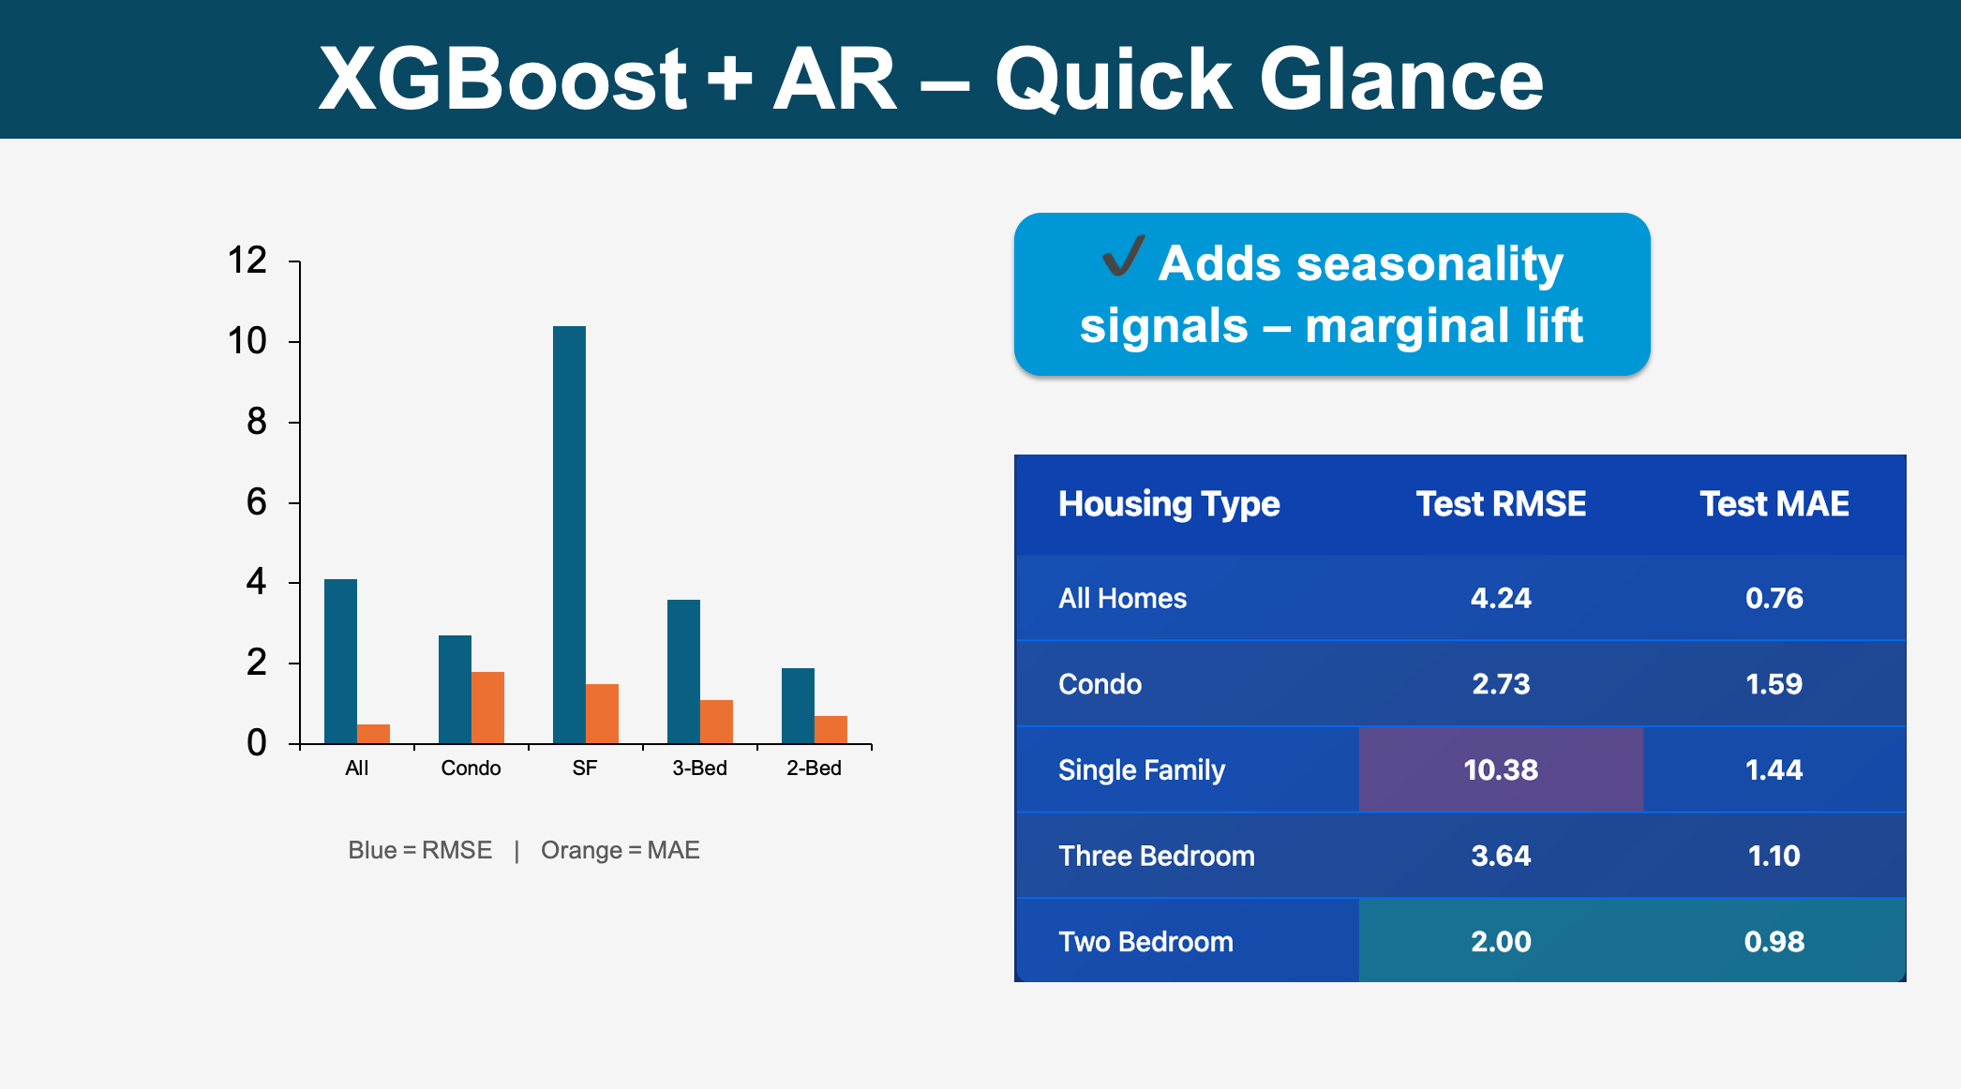
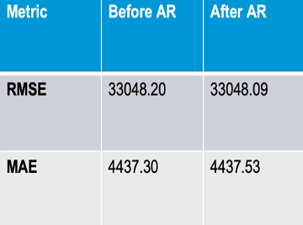
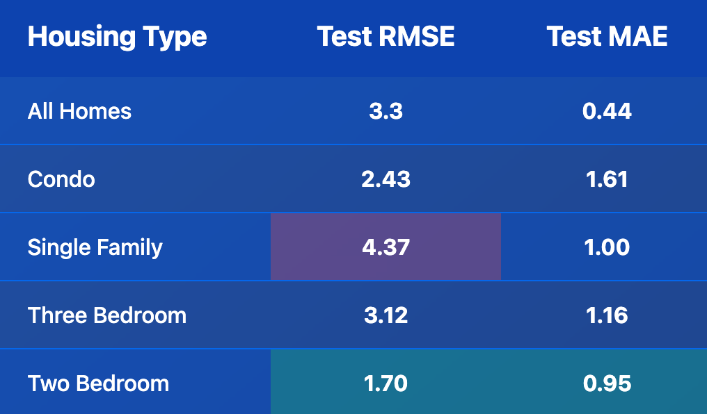
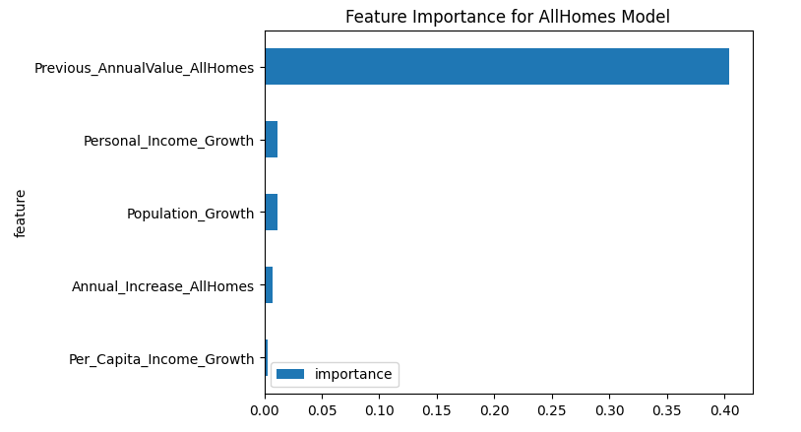
Extreme Gradient Boosting XGBoost ⟷ XGBoost + AR
Baseline
With AR
🏆 3.3 RMSE ↓ with AR lag

Slide 22
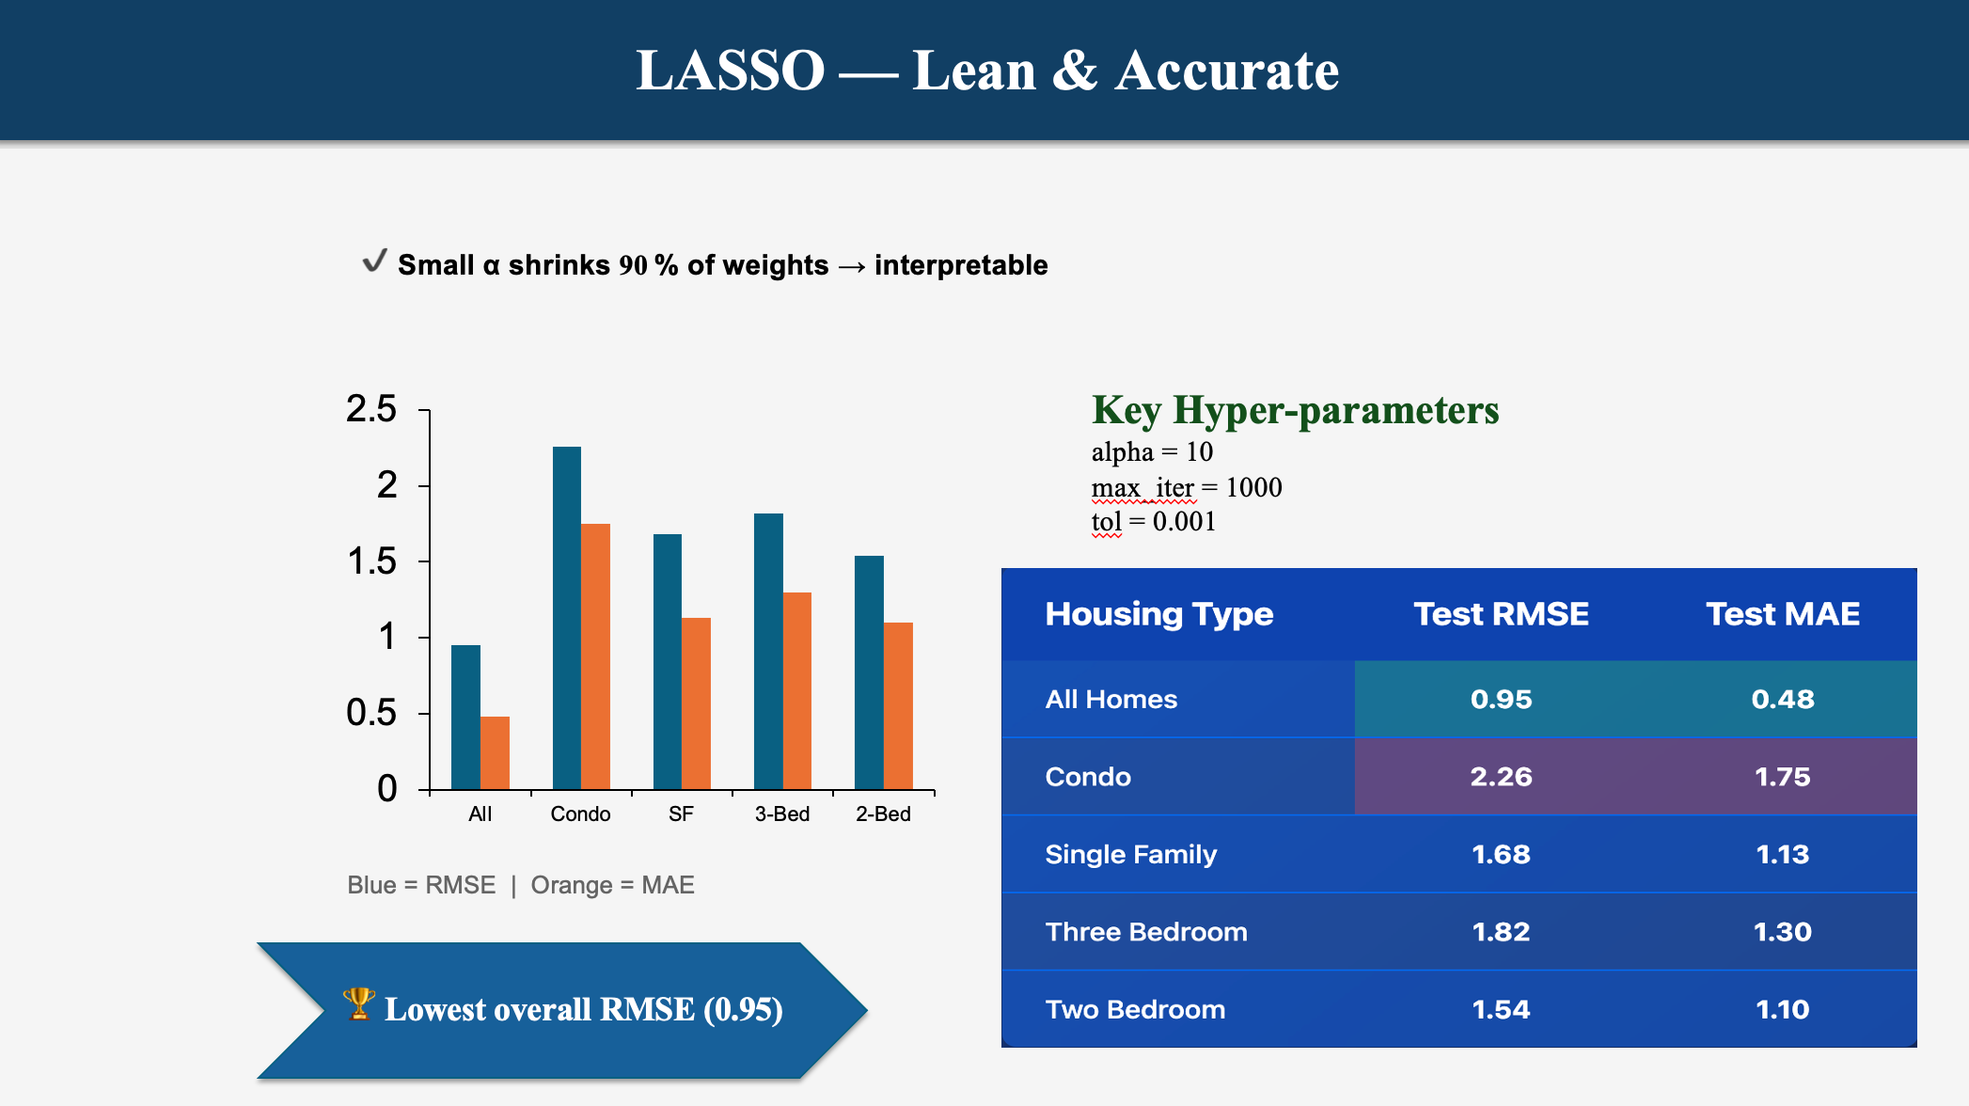
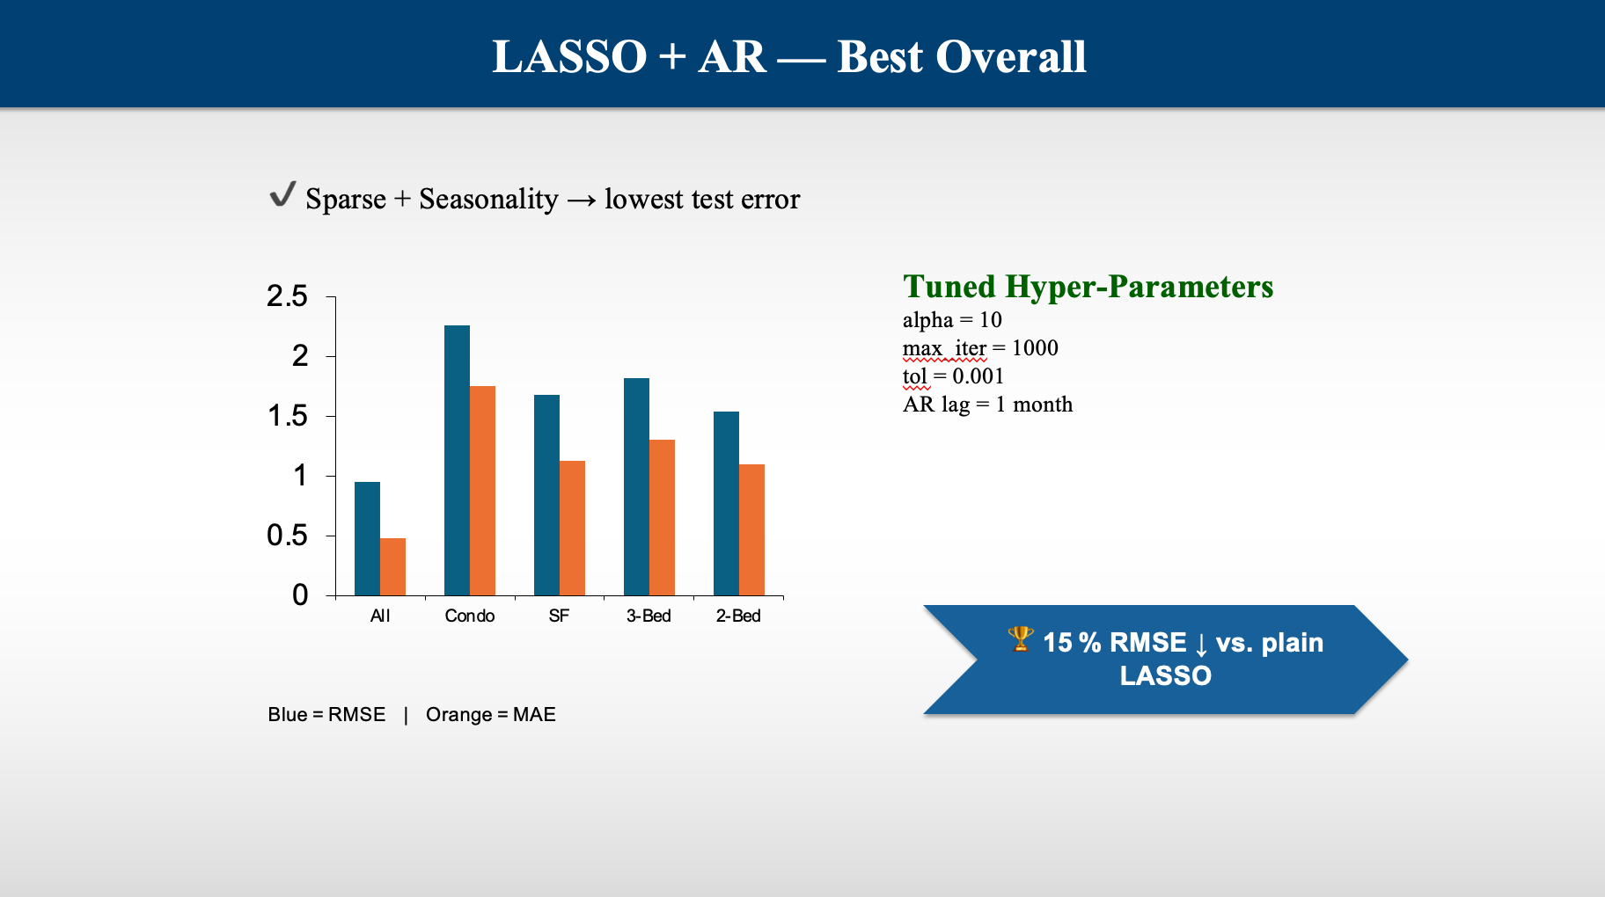
Least Absolute Shrinkage and Selection Operator (LASSO) vs LASSO + AR — What the Numbers Say
↓ 0.95 RMSE vs. plain LASSO
🏆 0.95 lower RMSE with AR lag — best overall trade‑off)

Slide 23
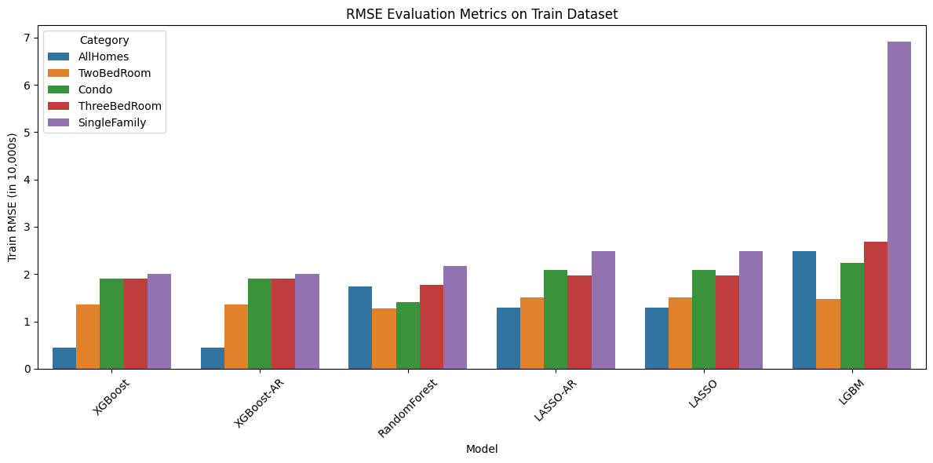
Model Evaluation on Train Data

Slide 24
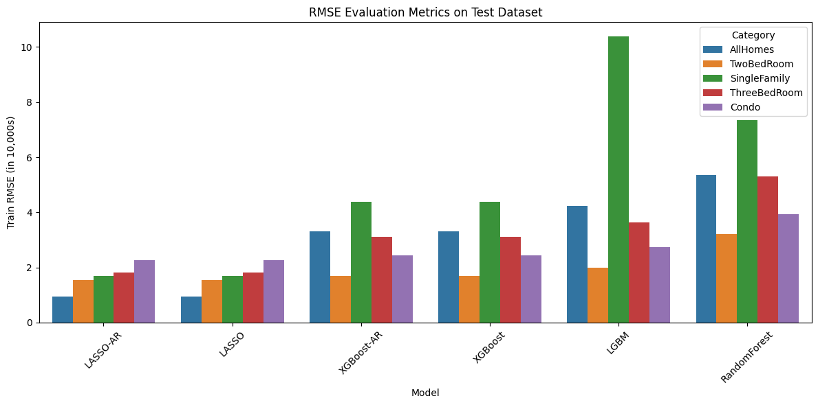
Model Evaluation on Test Data

Slide 25
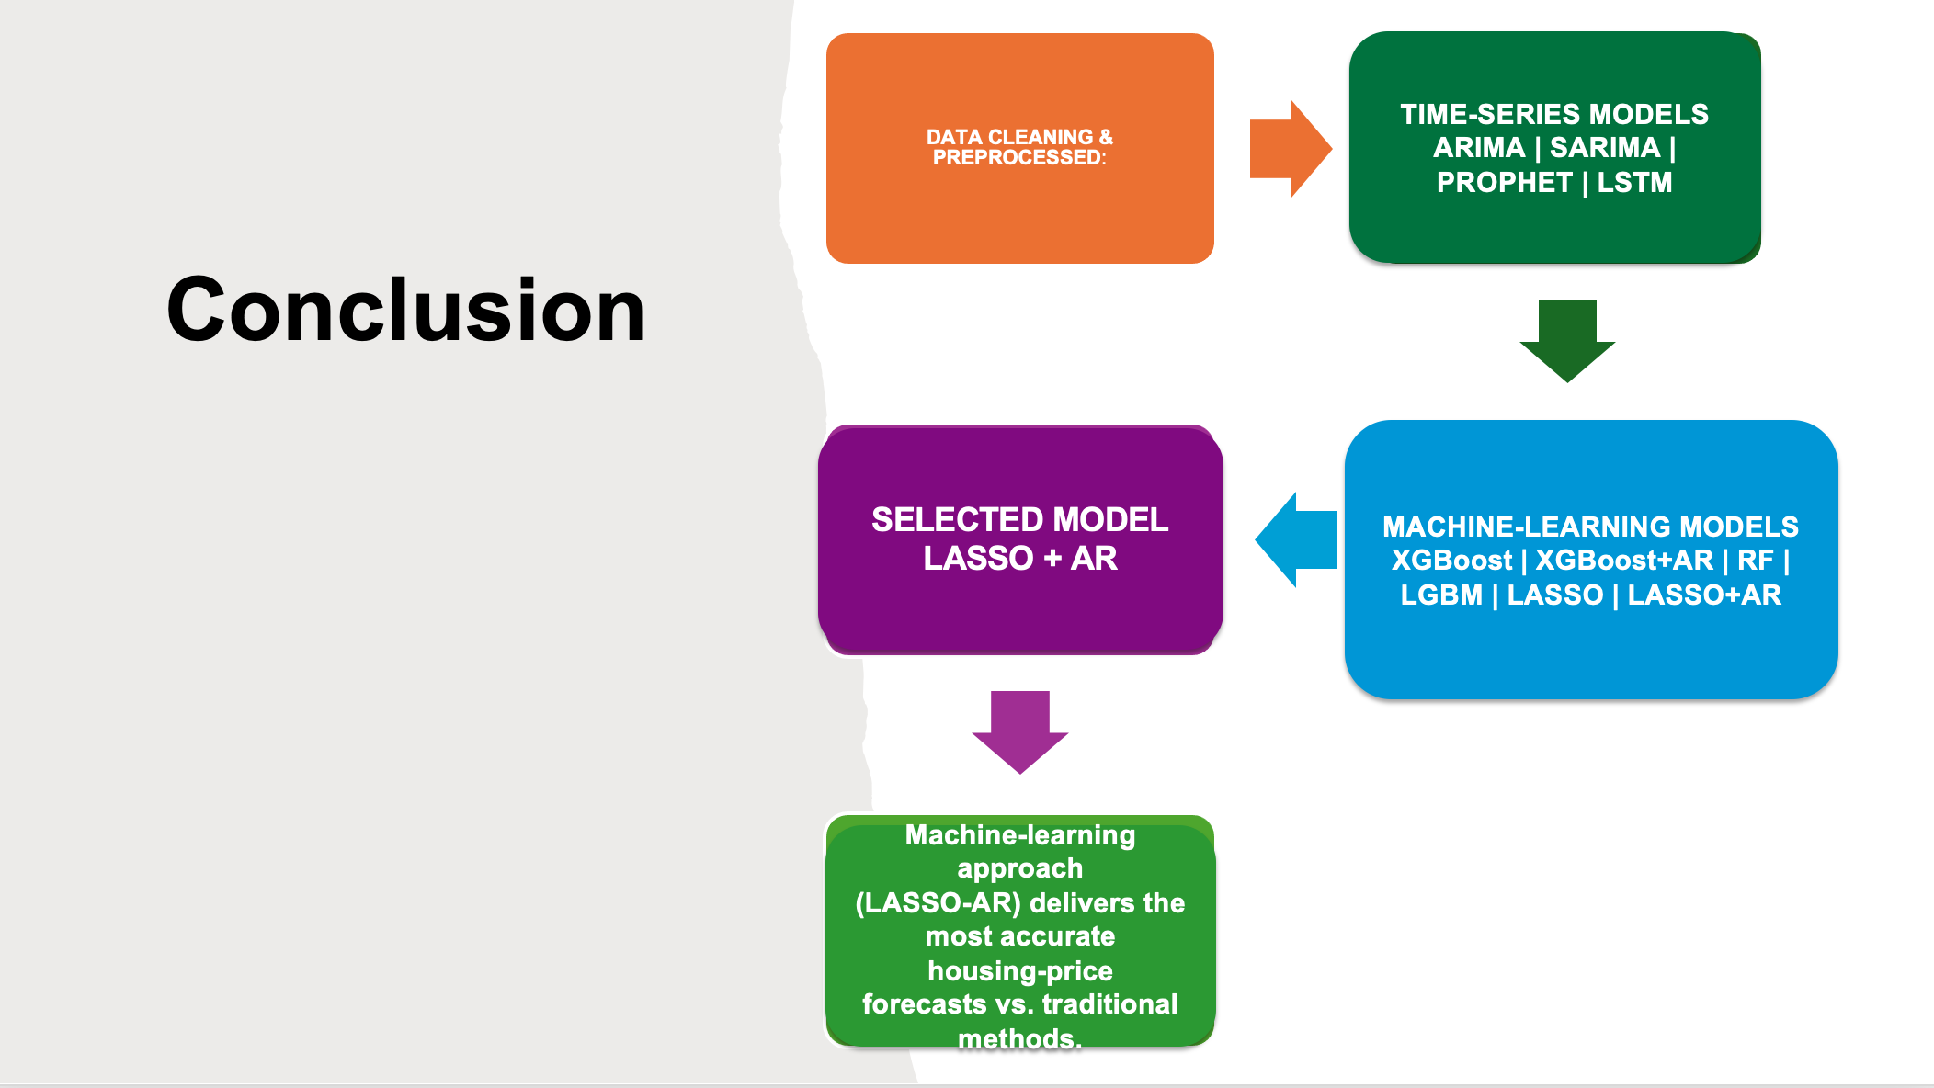
Conclusion

Slide 26
Future Roadmap – Key Enhancements
🔄 Real‑time Data Feeds
Hook Zillow & BEA APIs for live refresh
🗺️ GIS Dashboards
Interactive county heat‑maps
🚀 Model Deployment
Serve predictions via REST / Streamlit
💹 Macro Factors
Add rates, CPI & mortgage data

